Slide 1
Cardiovascular system
Cardiac Muscle; The Heart as a Pump
Function of the Heart Valves
Circulatory system.

Slide 2
HEART
Right heart, pumps blood through the lungs.
Left heart that pumps blood through the peripheral organs.
Hearts is a two-chamber, atrium and a ventricle.
Atrium is a weak primer pump, helping to move blood into the ventricle.
Ventricles supply the main pumping force either:
(1) Right ventricle>>>>pulmonary circulation
(2) Left ventricle>>>> peripheral circulation.
Continuing succession of heart contractions of the heart by cardiac rhythmicity, transmitting action potentials throughout the cardiac muscle to cause the heart’s rhythmical beat.

Slide 3
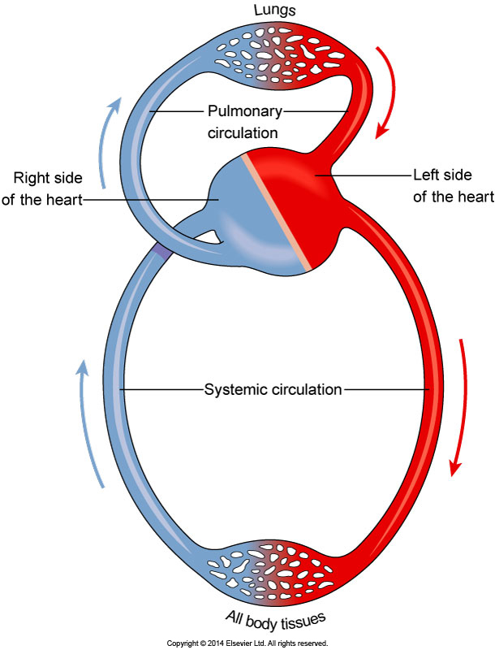
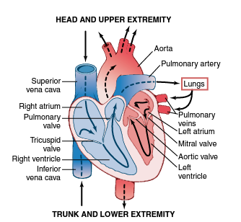

Slide 4
Physiology of Cardiac Muscle
The heart is composed of 3 types of cardiac muscle:
A - Atrial muscle
B - Ventricular muscle
C- Specialized excitatory and conductive muscle fibers.
The atrial and ventricular types of muscle contract in much the same way as skeletal muscle, except that the duration of contraction is much longer.

Slide 5
excitatory and conductive fibers
Exhibit either automatic rhythmical electrical discharge in the form of A.P or conduction of the A.P through the heart, providing an excitatory system that controls the rhythmical beating of the heart.

Slide 6
cardiac muscle
cardiac muscle has myofibrils; actin and myosin filaments identical to skeletal muscle.
Contraction in the same manner as occurs in skeletal muscle, except that the duration of contraction is much longer.

Slide 7
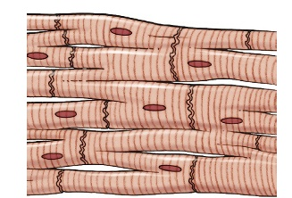
Cardiac Muscle as a Syncytium
The dark areas crossing the cardiac muscle fibers called intercalated discs.
they are cell membranes that separate individual cardiac muscle cells from one another.
At each intercalated disc the cell membranes fuse with one another to make gap junctions that allow rapid diffusion of ions longitudinal axes of the cardiac muscle fibers.

Slide 8
Cardiac Muscle as a Syncytium
So A.P travel easily from one cardiac muscle cell to the next.
Thus, cardiac muscle is a syncytium; in which when one of these cells becomes excited, the A.P spreads to all of them, from cell to cell.

Slide 9
Cardiac Muscle as a Syncytium
The heart is composed of two syncytiums:
1- atrial syncytium: two atria.
2- ventricular syncytium: two ventricles.
The atria are separated from the ventricles by fibrous tissue. A.P are not conducted from the atrial syncytium into the ventricular syncytium directly through this fibrous tissue. only by way of a specialized conductive system called the A-V bundle.
>>>> Two functional syncytiums allows the atria to contract a short time ahead of ventricular contraction, which is important for effectiveness of heart pumping.

Slide 10
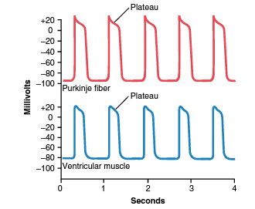
Action Potentials in Cardiac Muscle
Rhythmical A.P in a ventricular muscle fiber and Purkinje fiber rises from about −85 mV to +20 mV, during each beat.
membrane remains depolarized for 0.2 sec; a plateau. causes
ventricular contraction
to last 15 times as long
in skeletal muscle.

Slide 11
Plateau >> why in cardic muscle
Because in:
1- Skeletal muscle: A.P is generated “fast” Na-VGC channels; open and close rapidly ( about 5 msec). In, repolarization occurs rapidly.
Cardiac muscle : A.P by two channels, (1) small Na-VGC (2) high number of slow open and close Ca-VGC ( also called Ca-Na VGC) , remain open for several tenths of a second.
This maintains a prolonged period of depolarization; plateau in the A.P. Further, inflow Ca++ initiate muscle contractile process.

Slide 12
Plateau
2- differ from skeletal muscle A.P, In Cardiac muscles permeability for K+ decreases about fivefold. Thus, time required to return membrane potential to RMP delay. Prolonged depolarization.
After 0.2 -0.3 sec Ca-Na VGC close, Membrane permeability to K increase >>>> to RMP.

Slide 13
Velocity of Signal Conduction in Cardiac Muscle.
The velocity of conduction of the excitatory A.P signal along both atrial and ventricular muscle fibers is about 0.3 to 0.5 m/sec, or about 1 ⁄ 10 the velocity in skeletal muscle fibers.
Velocity in heart conductive system, Purkinje fibers, is 4 m/sec, allows rapid conduction of the excitatory signal to the different parts of the heart.

Slide 14
Refractory Period of Cardiac Muscle.
During which a normal cardiac impulse cannot re-excite, which is about the duration of the prolonged plateau A.P

Slide 15
Excitation-Contraction Coupling
It is a mechanism by which the A.P causes the myofibrils of muscle to contract.
Like in skeletal muscle, A.P passes over the cardiac muscle membrane>>>> spreads to the interior of the cardiac muscle by (T) tubules >>> work on SR to cause release of Ca++ into sarcoplasm >> promote muscle contraction.
Different from skeletal muscle, Ca diffuse from SR and T-tubules themselves at the time of A.P ( Ca- VGC), >>> PROLONGED CONTRACTION.
Contraction is depends about ECF Ca++ - level.

Slide 16
So, Ca++ level of ECF ( T-tubules) is essential for enough cardiac muscle contraction. but in skeletal muscle depends on Ca++ in ER.
At the end of plateau, Ca-Na counter transporter remove Intracellular Ca. and by pump Ca concentrate in SR.
Duration of cardiac contraction 0.2-0.3 sec.

Slide 17
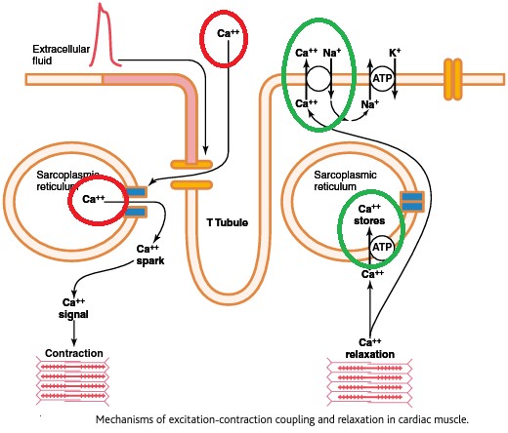

Slide 18
Cardiac Cycle
Cardiac events from the beginning of one heartbeat to the beginning of the next.
Start with spontaneous A.P in the sinus node, lateral wall of the R-atrium >>> A.P travels rapidly through both atria >>>> then through the A-V bundle into the ventricles.
Because of this special arrangement of the conducting system from the atria into the ventricles, A.P delay for 0.1 sec to the ventricles. This allows the atria to contract ahead of ventricular, thereby pumping blood into the ventricles before the strong ventricular contraction begins.

Slide 19
Diastole and Systole
Cardiac cycle, including systole and diastole (0.833 second per beat; 72/min)
Diastole: a period of relaxation in cardiac cycle , during which the heart fills with blood (about 0.6 second from cardiac cycle).
Systolic cycle: during which heart is contracted (about 0.2 sec of cardiac cycle).
During cardiac cycle events of pressure changes in the aorta, left ventricle, and left atrium appear.

Slide 20
Atria as Primer Pumps
Initially, Blood flows from the great veins into the atria; then 80 % of the blood flows from atria into the ventricles before the atria contract.
Atrial contraction causes an additional 20 % filling of the ventricles.
Thus, the atria just increase the ventricular pumping effectiveness as much as 20 %.
In resting state without this extra 20 % heart effectiveness is normal because it normally has the capability of pumping 300 to 400 % more blood than is required.

Slide 21
Pressure Changes in the Atria
First wave, atrial contraction 5-8 Hg.
Second wave backflow of blood into the atria at the onset of ventricular contraction and bulging of the A-V valves backward to atria because of increasing pressure in the ventricles.
Third at end of ventricular contraction; it results from slow flow of blood into the atria from the veins while the A-V valves closed.
when ventricular contraction is over >> A-V valves open>>stored atrial blood to flow rapidly into the ventricles and causing this wave to disappear.

Slide 22
Cardiac cycle phases:
A- Ventricles at diastolic (filling phase)
B- Period of Iso-volumic (Isometric) Contraction.
C- Period of Ejection.
D- Period of Iso-volumic (Isometric) Relaxation.

Slide 23
A- Ventricles at diastolic (filling phase)
In the end of systole ventricular pressures >>> start diastolic:
1- ventricular pressure drop / atrial pressure moderate higher >>> A-V valves open and allow blood to flow rapidly into the ventricles (period of rapid filling of the ventricles, lasts for about the first third of diastole).
2- During the middle third of diastole, only a small amount of blood normally flows into the ventricles (from the veins mainly).
3- During the last third of diastole, the atria contract and give an additional inflow of blood into ventricles; 20 % of total filling blood.

Slide 24
B- Period of Isovolumic (Isometric) Contraction. During Systole
ventricular contraction >>> ventricular pressure rises >> causing the A-V valves to close.
additional 0.02 to 0.03 sec to build up sufficient pressure to push the semilunar (aortic and pulmonary) valves open against the pressures in the aorta and pulmonary artery.
No emptying. This is called the period of isovolumic or isometric contraction (tension increasing in the muscle no shortening of the muscle fibers).

Slide 25
C-Period of Ejection.
left ventricular pressure rises slightly above 80 mm Hg (right one above 8 mm Hg) push the semilunar valves open.
About 70 % of the blood emptying occurring during the first third (rapid ejection period), remaining 30 % emptying during the next two third (the period of slow ejection).

Slide 26
D-Period of Isovolumic (Isometric) Relaxation.
At the end of systole.
ventricular relaxation >>right and left intraventricular pressures to decrease rapidly.
Elevated pressures in large arteries filled with blood from the contracted ventricles push blood back toward the ventricles > close the aortic and pulmonary valves.
Intraventricular pressures decrease back to their low diastolic levels. Then the A-V valves open to begin a new cycle of ventricular pumping.

Slide 27
“Volume-Pressure Diagram” During the Cardiac Cycle
explain pumping mechanics of the left ventricle;“diastolic pressure/systolic pressure.”

Slide 28
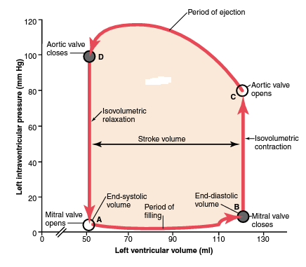
Relationship between left ventricular volume and intra-ventricular pressure during diastole and systole

Slide 29
End-Diastolic Volume, End-Systolic Volume, and Stroke Volume Output.
During diastole, volume of each ventricle increases to about 110 to 120 ml;end-diastolic volume.
As the ventricles empty during systole, the volume decreases about 70 ml, which is called the stroke volume output.
The remaining volume in each ventricle, about 40 to 50 ml, is called the end- systolic volume.
The fraction of the end-diastolic volume that is ejected is called the ejection fraction —usually equal to about 60 %.
IF heart contracts strongly, the end-systolic volume can be decreased to 10 to 20 ml.
when large amounts of blood flow to ventricles during diastole, the end-diastolic volumes can become 150 to 180 ml.
By both cases, stroke volume output can be increased to more than double normal.

Slide 30
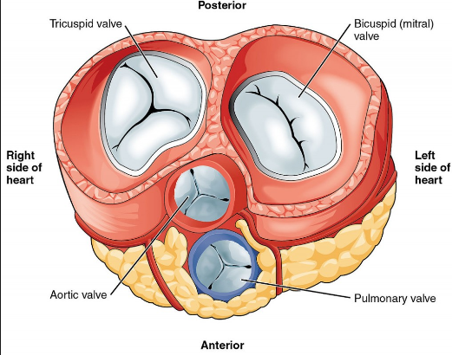
Valves cardic
The valves incorporate leaflets or cusps, open and close to control blood flow.
1- The mitral valve (LAV) with two cusps.
2- tricuspid valve (RAV) with three cusps.
3- semilunar aortic and pulmonary valve has three cusps.

Slide 31
Function of the Valves
The A-V valves (the tricuspid and mitral valves) prevent backflow of blood from the ventricles to the atria during systole.
semilunar valves (the aortic and pulmonary artery valves) prevent backflow from the aorta and pulmonary arteries into the ventricles during diastole.
These valves close and open passively with pressure gradient.

Slide 32
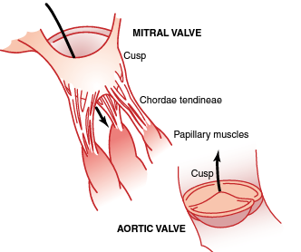
Function of the Papillary Muscles
The papillary muscles contract when the ventricular walls contract.
but they do not help the valves to close. Instead, prevent their bulging too far backward toward the atria during ventricular contraction.

Slide 33
chemical Energy Required for Cardiac Contraction: Oxygen Utilization by the Heart
Heart muscle, like skeletal muscle, uses chemical energy to provide the work of contraction.
70 to 90 % of this energy is derived from oxidative metabolism of fatty acids , while another part from lactate and glucose.
Efficiency of Cardiac Contraction: the ratio of work output to total chemical energy produced ( much converted into heat )
Maximum efficiency of the normal heart is between 20 and 25 %. In heart failure, this can decrease to as low as 5 to 10 %.

Slide 34
Regulation of Heart Pumping
at rest, the heart output only 4 to 6 L/Min.
During severe exercise, the heart may be required to pump 4-7 times this amount.
The basic means by which the volume pumped by the heart is regulated are:
(1) intrinsic cardiac regulation of pumping in response to changes in volume of blood
(2) control of heart rate and strength of heart pumping by the autonomic nervous system.

Slide 35
Intrinsic Regulation of Heart Pumping—The Frank-Starling Mechanism
venous return is the rate of blood flow into the heart from the veins.
The heart, automatically pumps this incoming blood (venous return) into the arteries so that it can flow around the circuit again.
Basically, the Frank-Starling mechanism means that the greater the heart muscle is stretched during filling (venous return), the greater is the force of contraction and the greater the quantity of blood pumped into the aorta.

Slide 36
Intrinsic Regulation of Heart Pumping—The Frank-Starling Mechanism
As venous return increases >>>> heart pumping increase by :
1- muscle contract with increased force because the actin and myosin filaments are brought to optimal degree of overlap (increase lengthening the heart muscle) for force generation >>> Therefore, automatically pumps the extra blood into the arteries.
2-Stretch of the right atrial wall directly increases the heart rate by 10 to 20 %.

Slide 37
Control of the Heart by the Sympathetic and Parasympathetic Nerves
The pumping effectiveness of the heart also is controlled by the sympathetic and parasympathetic (vagus) nerves.
cardiac output often can be increased more than 100 % by sympathetic stimulation.
By contrast, the output can be decreased to as low as zero or almost zero by vagal (parasympathetic) stimulation.

Slide 38
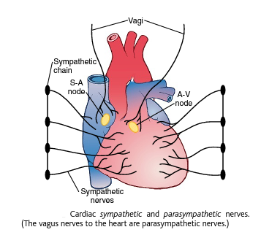

Slide 39
Sympathetic Nerves
Strong sympathetic stimulation can increase the heart rate from 70 beats/min up to 180 to 200 and, rarely, even 250 beats/min.
Also, sympathetic stimulation increases the force of heart contraction to as much as double normal.
thereby increasing the volume of blood pumped and increasing the ejection pressure.
Thus, sympathetic stimulation often can increase the maximum cardiac output as much as 2 to 3 fold, in addition to the increased output caused by the Frank-Starling mechanism.

Slide 40
inhibition of the sympathetic nerves:
when the activity of the sympathetic nervous system is depressed below normal:
1- decreases both heart rate
2- strength of ventricular muscle contraction,
thereby decreasing the level of cardiac pumping 30 % below normal.

Slide 41
Parasympathetic (Vagal) Stimulation of the Heart.
Strong stimulation in the vagus nerves >>> can stop the heartbeat for a few seconds>>> then the heart usually beats at a rate of 20 to 40 beats/min as long as the parasympathetic stimulation continues.
Also, strong vagal stimulation decrease the strength of heart muscle contraction by 20 to 30 %.
The vagal fibers are distributed to atria and not to ventricles, this explains the effect of vagal stimulation mainly to decrease heart rate rather than to decrease heart contraction.

Slide 42
Effect of K+ and Ca++ Ions on Heart Function
concentration of each of these two ions in ECF have important effects on cardiac pumping.
Excess K in the ECF causes the heart to become dilated and slows the heart rate. (8 to 12 mEq/L ) also can block conduction of the cardiac impulse from the atria to the ventricles through the A-V bundle. ( because it decreases the resting membrane potential in the cardiac muscle >> intensity of AP decreases >>> weak contraction).
An excess of Ca++ causes effects opposite to K ions, causing the heart to go toward spastic contraction.
Conversely, deficiency of Ca similar to the effect of high potassium.

